Slide 1
Global Marketing
Management
A European Perspective
GLOBAL LOGISTICS AND
CHANNEL DECISIONS
Warren J. Keegan
Bodo B. Schlegelmilch

Slide 2
The Nature of Global Logistics and Channel Decisions I
International distribution encompasses two areas of responsibility:
  Channel management
    identifying, selecting and supporting distribution partners
    distribution partners bridge the gap between manufacturer and customer
  Global logistics
    ensuring adequate supply
    the right products are made available to customers when and where they want them

Slide 3
The Nature of Global Logistics and Channel Decisions III
The value chain provides a useful framework for integrating various organisational activities related to global distribution
Today, distribution activities are becoming increasingly intertwined, i.e.
  sourcing material and parts for production
  taking care of product shipment
  selecting suitable distribution partners

Slide 4
In-Bound Logistics I
In-bound logistics describes the process of moving products and materials from suppliers to the factory
Six factors must be taken into account
  factor costs and conditions
  transport costs
  country infrastructure
  political risk
  market access
  currency issues

Slide 5
In-Bound Logistics II
Factor costs and conditions
  land
  labour, including the cost of workers
    manufacturing and production
    professional and technical
    management
  capital cost
The cost of these factors depends on
  availability
  relative abundance

Slide 6
In-Bound Logistics III
World factor costs that affect manufacturing
  industrialised countries
    factor costs are tending to equalise
  industrialising countries (Singapore, other Pacific Rim countries)
    offer significant factor costs savings
    offer an increasingly developed infrastructure and political stability
  Russia and other countries
    lower factor costs (especially wages) are offset by limited infrastructure development and greater political uncertainty

Slide 7
In-Bound Logistics IV
Transport Costs
Country Infrastructure
Political Risk
Market Access
Foreign Exchange

Slide 8
Out-Bound Logistics
Moving products from the factory to customers
It involves aspects of
  transportation,
  inventory control,
  order processing and
  warehousing

Slide 9
International Channel Strategies
The purpose of marketing channels is to create utility for customers
  place
  time
  form
  information
Two forms of channel strategy
  direct involvement
  indirect involvement

Slide 10
Global Trends in Channel Design and Strategy I
Global Retailing
  today
  future
Direct Marketing
  distribution system, where sales to customers are carried out via telephone, mail or door-to-door
  one-on-one approach is effective for products which need demonstration or complex explanation

Slide 11
Global Trends in Channel Design and Strategy II
E-Commerce and International Distribution Strategies
  Design of appropriate distribution systems
E-Tailing
  describes the increasing trend of retail operations globalising via the Internet
  presenting and selling a product range over the Internet gains increasing importance

Slide 12
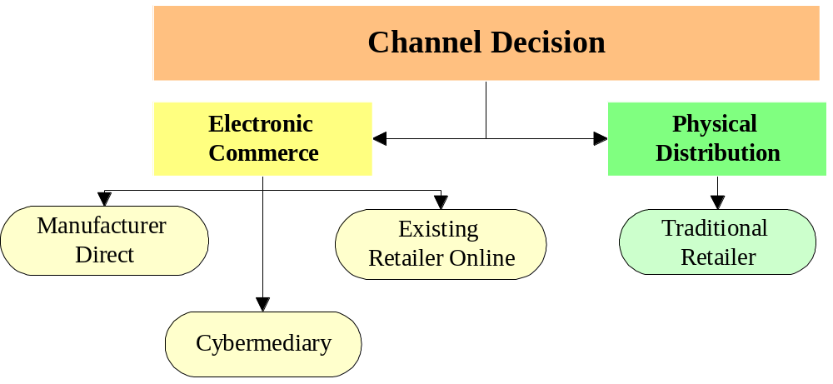
Global Trends in Channel Design and Strategy III
Alternative Channel Responses

